Slide 1

250
NT
04.14.2024
NUMPY
Introduction
Caption

Slide 2

Numpy - Introduction
Data Science Program
Session-1

Slide 3


Numpy Lesson Content
Introduction
Numpy Arrays
Concatenation & Indexing-Slicing
Broadcasting & Various Methods
What will we learn in Numpy lessons?

Slide 4
Numpy Lesson Content
Data Science LifeCycle
Numpy Introduction
IDE – Anaconda - Jupyter Notebook
Install & Import
Scalar – Vector – Matrix - Tensor
Numpy Arrays - Notebook
What will we learn today?

Slide 5

Have you studied today's pre-class materials?

Slide 6
Data Science

Slide 7

Data Science LifeCycle

Slide 8
Data Science LifeCycle

Slide 9
Data Science LifeCycle

Slide 10
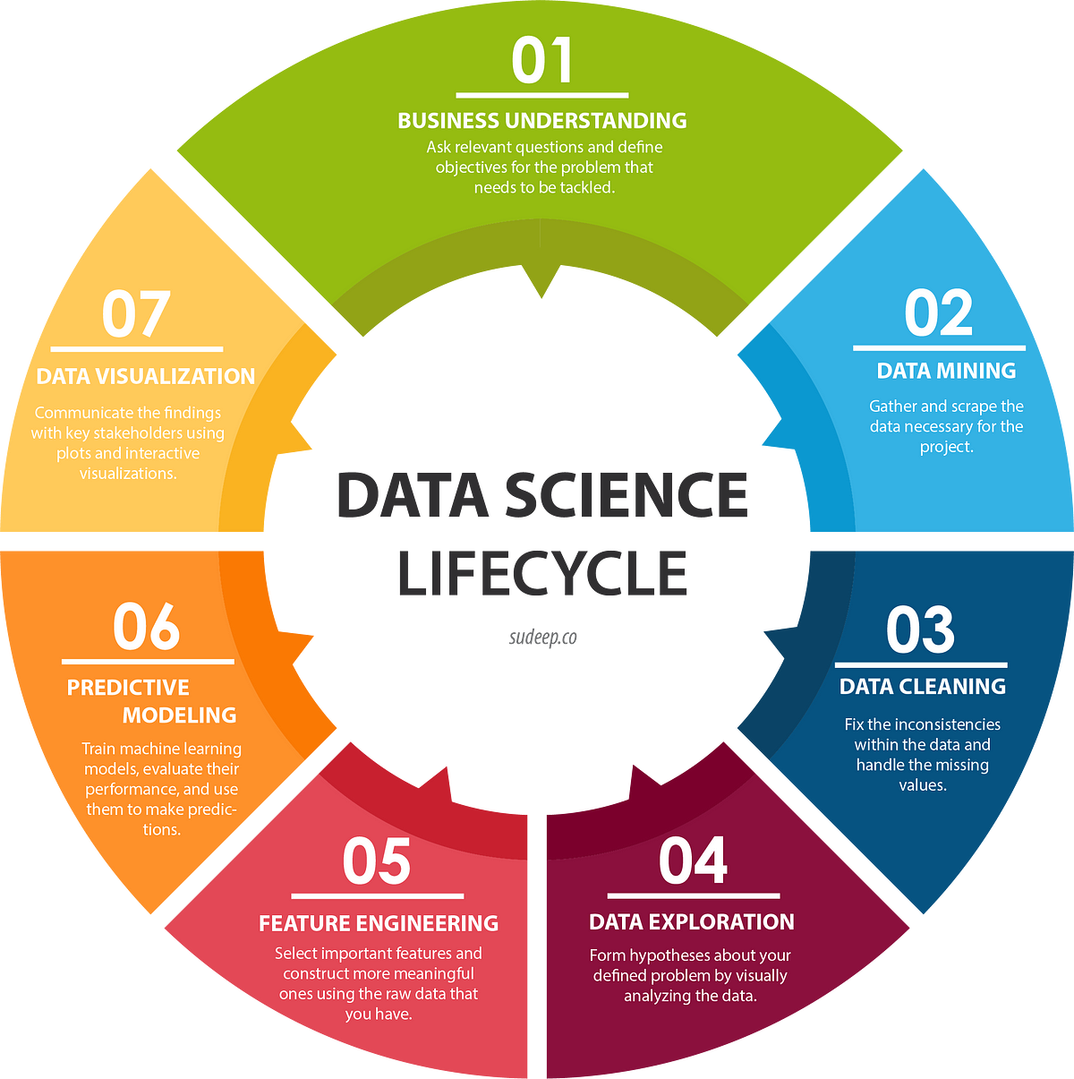
Data Science LifeCycle

Slide 11

Numpy
Numerical Python
It allows us to work with multidimensional arrays and matrices.
We can perform mathematical operations.
NumPy arrays

Slide 12
Numpy
Why Use NumPy?
Faster
fewer cycles
Clearer code
Better quality code

Slide 13
Numpy
Why is NumPy Faster than Lists?
Memory management
Vector operations
Internal functions
Infrastructure written in C or C++

Slide 14
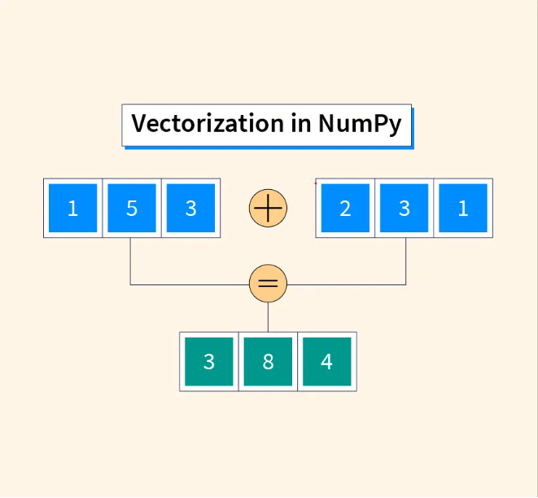
Vectorization

Slide 15
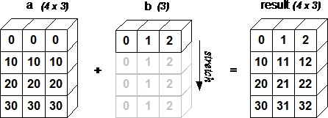
Broadcasting

Slide 16
IDE
Integrated Development Environment (IDE)
IDE is an application designed to simplify the software development process.
It offers many features such as writing code, debugging, version control and code execution in a single interface.
PyCharm, Visual Studio etc.

Slide 17
Anaconda
It is a popular Python and R distribution for scientific computing and data science.
It is specifically designed for scientific computing, data analysis, data science, machine learning and artificial intelligence projects.
Besides the core Python language, it includes many popular libraries (NumPy, Pandas, Matplotlib) and Jupyter Notebook.

Slide 18
Anaconda - Advantages
Comprehensive Package Collection
Conda Package Manager
Virtual Environments
Cross Platform
Tools and IDEs
Easy setup

Slide 19
Jupyter Notebook
It is a web-based interactive programming environment designed for data scientists and researchers.
Interactive Programming
Documentation and Note Taking
Data Visualization
Sharing
Plugins and Extensions
Wide Language Support

Slide 20
Jupyter Notebook (Julia & Python & R )
You can use Jupyter Notebook without installing Anaconda.
To install and use Jupyter Notebook:
1. Open the command line and enter the following command:
pip install jupyter
2. Enter the following command in the command line to start:
jupyter notebook
This command will launch the Jupyter Notebook interface in your default web browser.

Slide 21
Install & Import
pip install numpy
import numpy as np

Slide 22
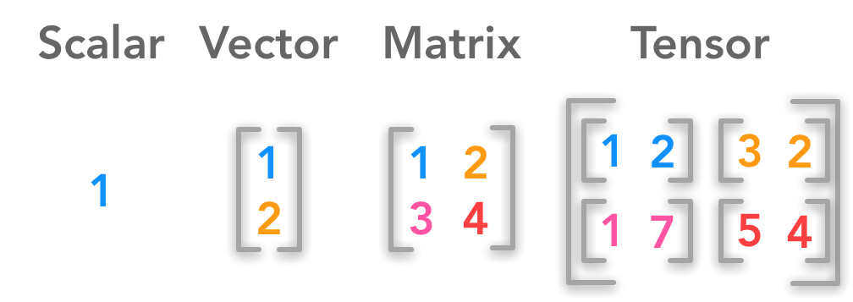
Scalar-Vector-Matrix-Tensor
Scalar (0D Array): A simple element with a single value
Vector (1D Array): An ordered list of elements
Matrix (2D Array): A table or grid of ordered elements. It has two axes: rows and columns.
Tensor (3D Array): A structure in which elements are arranged in layers. It has three axes: width, height and depth.

Slide 23
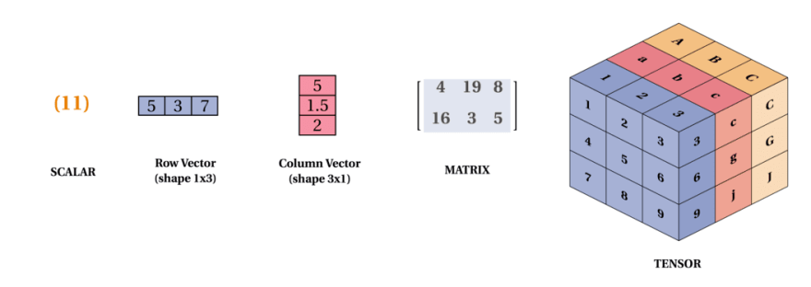
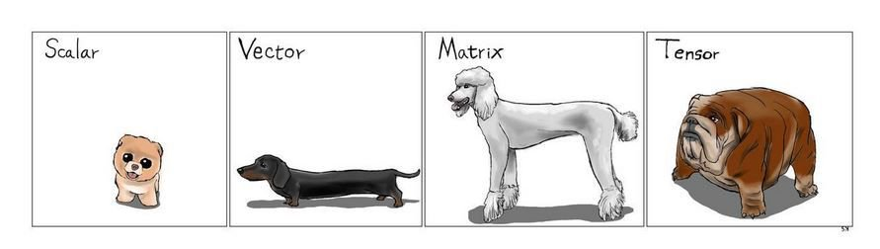
Scalar-Vector-Matrix-Tensor

Slide 24
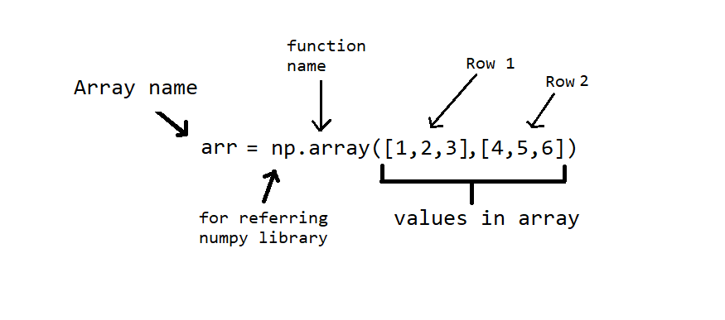
Syntax

Slide 25
TIME TO PRACTICE

Slide 26

Do you have any questions?

Slide 27

Next Session
Numpy Array Methods
Numpy Array Methods
(arange, linspace, logspace, zeros, ones, eye, full)
Various Bulit-in Methods
(rand, max, min, ndim, size vb.)
What will we learn in the next lesson?

Slide 28


